Slide 1
Network Compression
Instructor: Dr. Yan Yan

Slide 2

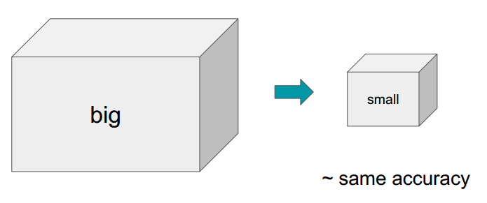
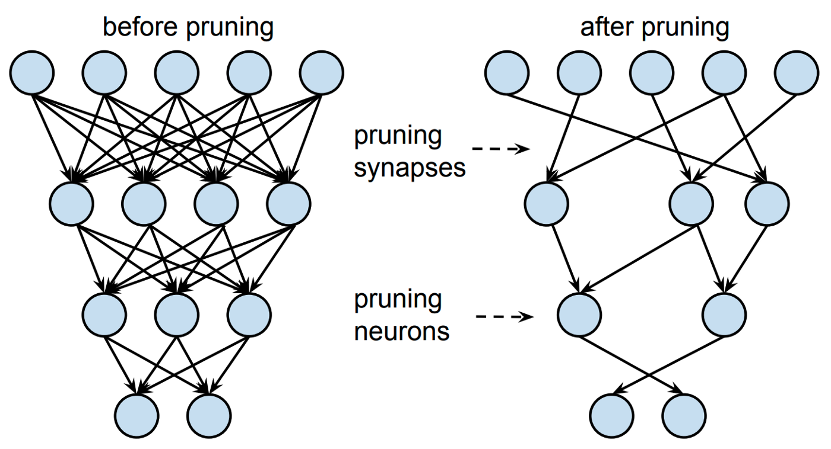

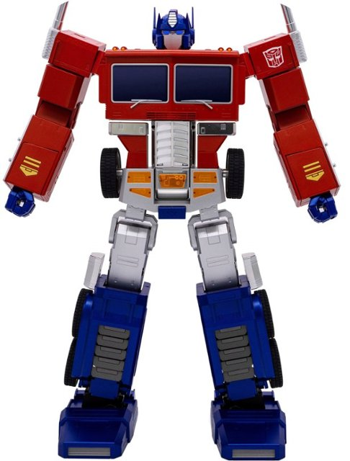
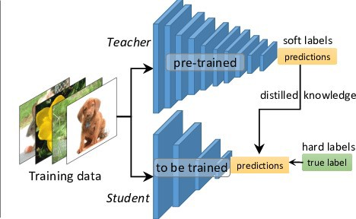
Overview
Deploying DL models in resource-constrained environments with Lower latency, Privacy, etc.
Model Compression
Set individual parameters to zero and make the network sparse.
Remove entire nodes from the network.
Model Pruning
Transfer the knowledge from a large model or set of models to a single smaller model.
Knowledge Distillation

Slide 3
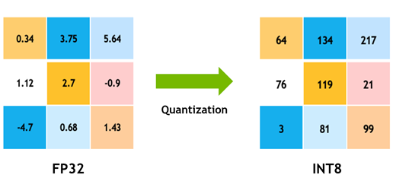
Overview
Quantization
Reduce the precision of the weights, biases, and activations such that they consume less memory.
Going from 32-bit to 8-bit, for example, would reduce the model size by a factor of 4, so one obvious benefit of quantization is a significant reduction in memory.

